Slide 1
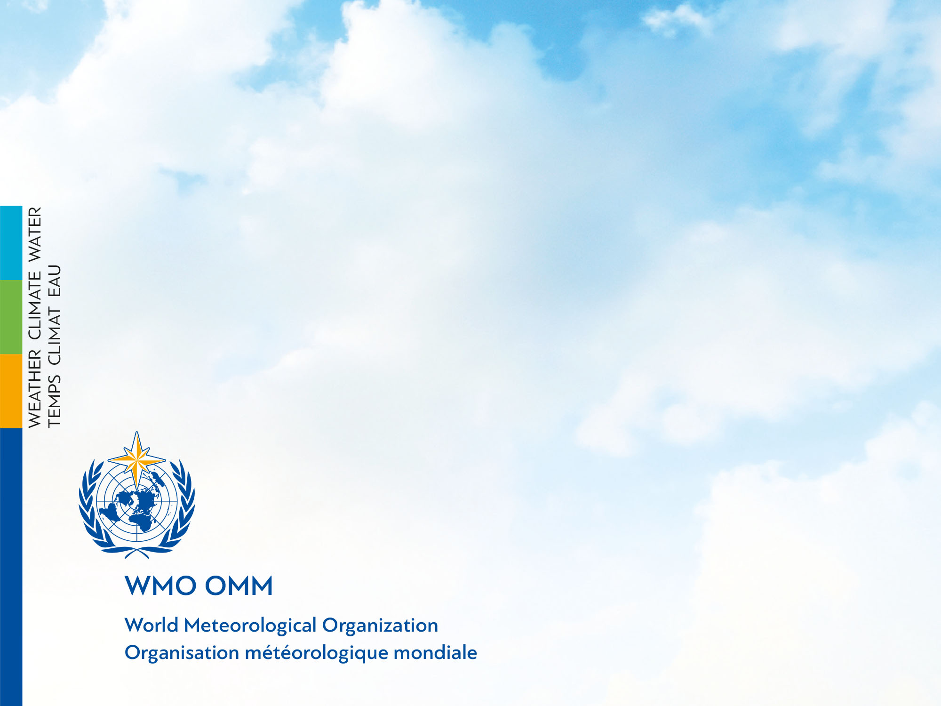
Southern Africa Regional Training Workshop on SARFFGS, Severe Weather Forecasting (GDPFS) and Warning Services Delivery (PWS)
Pretoria, South Africa, 24 October-4 November 2016
WMO’s
Severe Weather Forecasting Demonstration Project (SWFDP):
Contributing to building resilience and improving DRR
Ata HUSSAIN
DPFS Division, WMO Secretariat

Slide 2
What do NMHSs produce?
For example
Toyota/ Volkswagen produce cars
Samsung produces Multimedia, TV, cell phones etc.
NMHSs produce decision-supportive information and services
(e.g. observations, data, weather/climate bulletins, NWP products, weather/climate forecasts, alerts, advisories, warnings etc.)

Slide 3
Weather: A basic function of NMHSs & a core business of WMO
The Weather business can be defined as integrated process of providing weather and climate information and services.
As part of Weather business, the weather information and services is a basic function of NMHSs and a core business of WMO (from nowcasting to longer-time scale ˜1 month)
Weather is daily business of NMHSs and 'extreme weather events' have direct relevance to climate extreme and DRR/DPM
Forecasting and warning services for high impact weather are highly important for public safety, DRR and sustainable socioeconomic development. For example, impact of a tropical cyclone can alone be very devastating in terms of loss of life and property as well as for the economy of a small country (like TC Haiyan impact on Philippines, TC Pam impact on Vanuatu, and TC Matthew impact on Haiti)
Weather is also a manifestation of climate change/ variability which can potentially cause severe weather to become more intense and/or frequent. This creates challenges for NMHSs to improve their weather and information services in order to meet the users’ needs in climate change environment.
Notes:
For small countries a single severe event can have serious impact on socioeconomic conditions and even it can shatter the course of development

Slide 4
Weather: A basic function of NMHSs & a core business of WMO
The weather information and services from nowcasting (0-6h) to longer-time scale (˜1 month)): a basic function of NMHSs and a core business of WMO.
-------------------------------------------------
-------------------------------------------------
Mostly hydrometeorogical hazards and disasters occur due to severe weather phenomena (e.g. heavy rains, flash flood, severe thunderstorms including tornados, strong winds, tropical cyclones and associated storm surge and coastal inundation, dust/sand storms, heat waves, cold waves etc.)
Notes:
Weather vs Climate range. Weather from time recent to a little over a 1 month. Climate starts with sub-seasonal to seasonal. Hydrometeorological conditions are the result of weather conditions. Most of the hydrometeorological hazards occur within time frame of minutes to a few week.

Slide 5
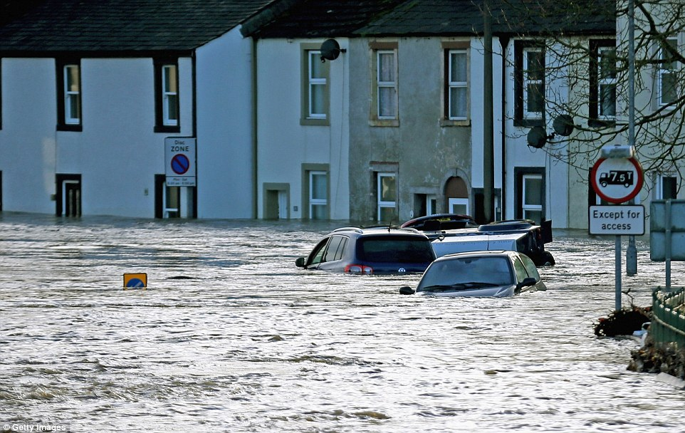
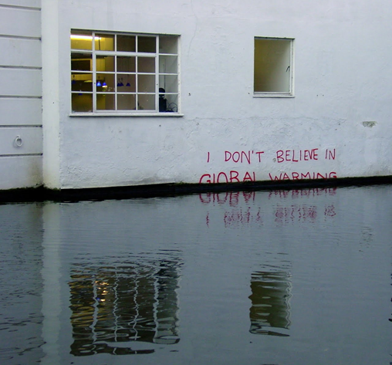
Climate change/ variability vs Weather events
The flooding can be due to the direct impact of heavy rain which is a ‘severe weather’ event
large-scale influences
A heavy rain event can be due to climate change/climate variability
‘chaos’
which is manifested through weather events.
dry
wet
Notes:
Climate change/ variabilty vs weather event. The effect of accumulation of individual weather events, is influenced by the large scale circulations like El Nino, La Nina, SST, and it has implications for climate variabilty resulting in wetter or drier climate conditions.

Slide 6
Weather application sectors and service delivery aspects
Weather information and services application sectors are several, including: DRR, Aviation, Marine, Agriculture, Environment, Energy, Transportation, Tourism, Health, Sports etc. They are growing in number and becoming more sophisticated.
The nature of services provided by NMHSs are of information type and they aim at supporting decision-making.
Tools and guidance are necessary to facilitate NMHSs provision of services.
Another important characteristics or attribute of these services is that they have to generate social and economic value to individual users as well as to the economic sector and/or to the community as a whole.
Notes:
Some of the major application areas has been recognized in WMO strategic plan such as DRR and Aviation, while others such as Agriculture, Health and Energy has been identified as priorities of GFCS. In addition, there is increasing demand of services for Transportation, Environment, Urban application, Tourism which are weather and climate dependent for building resilience and sustainable development. Based on WMO and its Members progress and achievements in applications and services delivery, how can we assist our Members including NMHSs and partners to develop and implement integrated and holistic approaches on effective applications and efficient services delivery?

Slide 7
Origin of the WMO’s
World Weather Watch (WWW) Programme
UN General Assembly XVI (December 1961) adopted Resolution 1721 “International Cooperation in the Peaceful Uses of Outer Space”.
WMO was requested to study measures to advance the state of atmospheric science and technology and to develop weather forecasting capabilities
WMO Cg-IV(1963) created World Weather Watch (WWW) programme composed of GDPS, GOS and GTS operated by WMO Members for the collection, analysis and dissemination of meteorological data and processed products
On Recommendation of CBS-Ext (2002), Cg-XIV (2003) changed GDPS to GDPFS

Slide 8
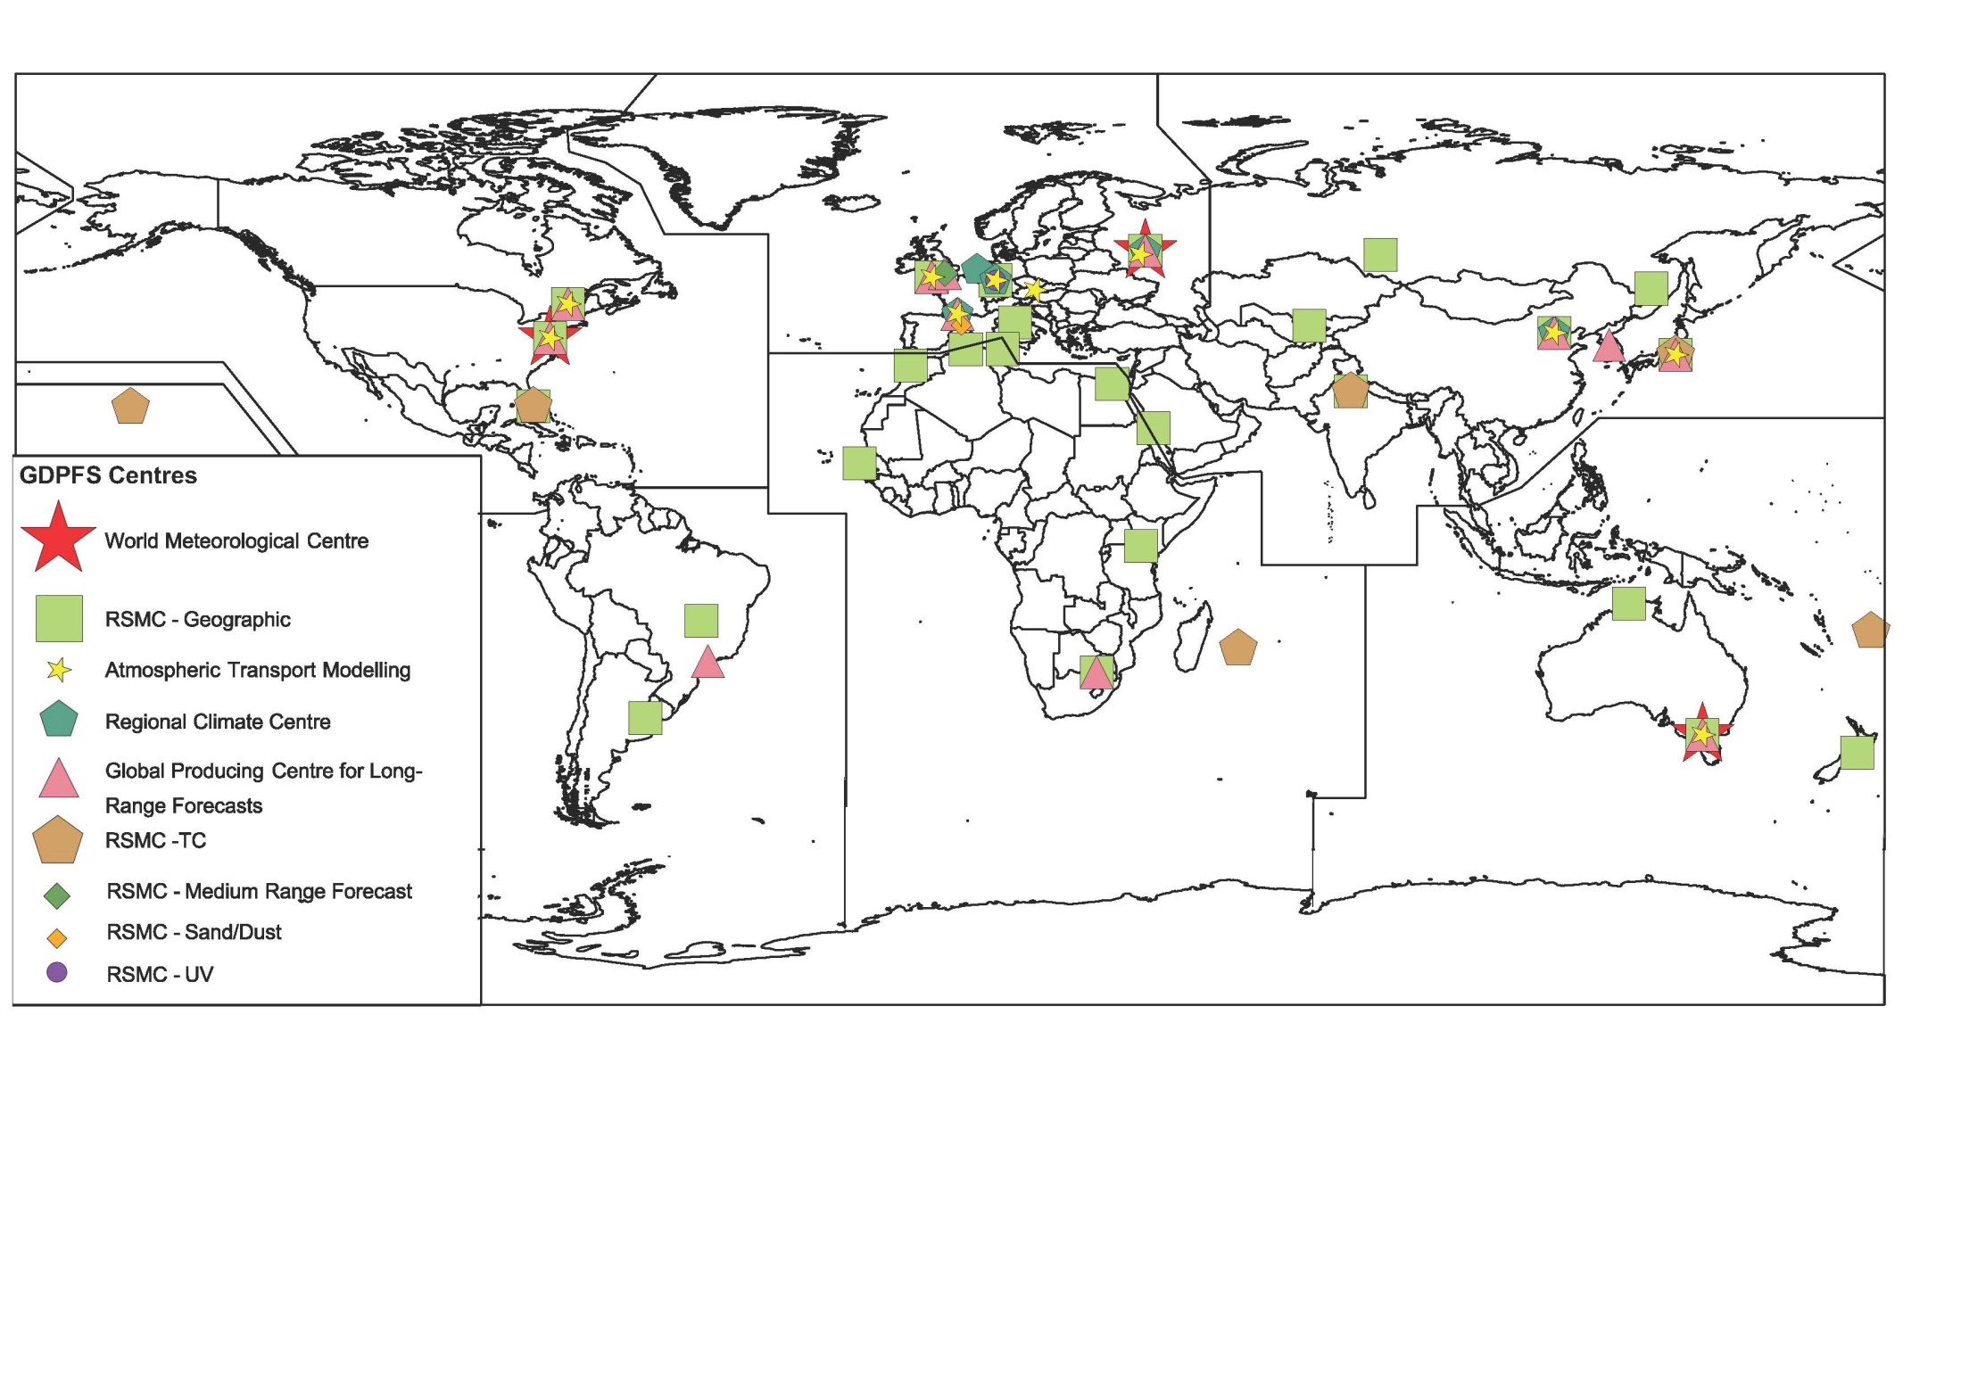
The Global Data Processing and Forecasting System (GDPFS)
As part of WWW, the GDPFS is the world-wide network of operational centres operated by WMO Members
Its purpose is, in operational conditions, to make available among WMO Members, agreed products and services for applications related to weather, climate and water, and related environment
3 WMCs
25 RSMCs with Geographical Specialization and 16 with Activity Specialization
12 GPCs (for LRF)
5 RCCs and 1 RCC-Network
All NMCs
GDPFS is organized as a three-level system to carry out functions at global, regional and national levels
Notes:
The GDPFS is the world-wide network of operational centres operated by WMO Members. It is organized as a three-level system to carry out functions at global, regional and national levels. There are three World Meteorological Centres, two in in Northern Hemisphere (in USA and Russian Federation), and 1 in Southern Hemisphere (Australia). There is a network of Regional Centres including RSMCs and RCCs

Slide 9
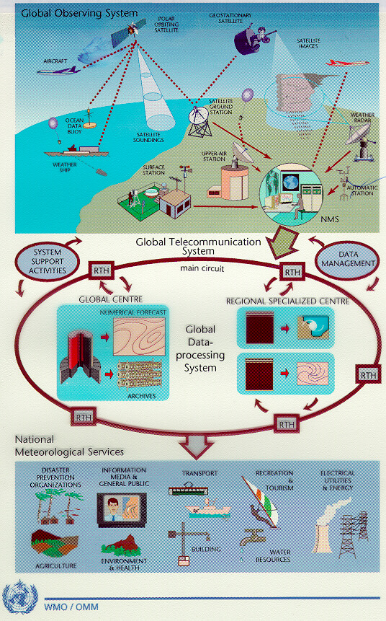
WMO operational networks
191 NMHSs: satellites, land, ships, buoys, and aircraft contribute to Global Observing every day
WIGOS
Global Telecom with Regional Hubs –
becoming the WMO
Information System (WIS)
WIS
The GDPFS:
Global, Regional Specialized Met. Centres (RSMC, RCC), and National Centres
GDPFS
Service delivery
NMHSs deliver analyses, forecast and early warning services

Slide 10
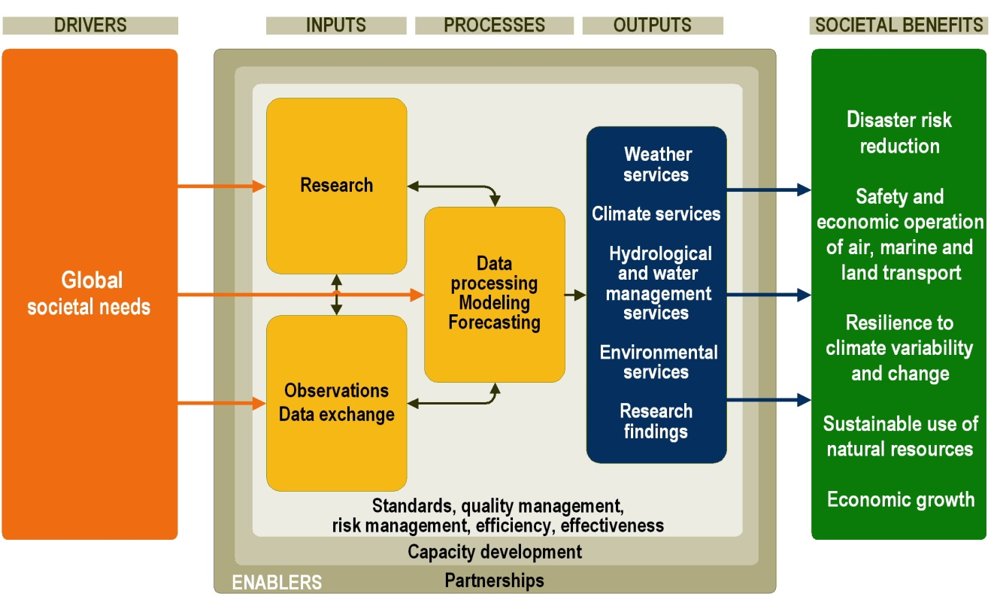
GDPFS at the heart of the WMO operational system
Source: WMO 2016-2019 Strategic Plan

Slide 11
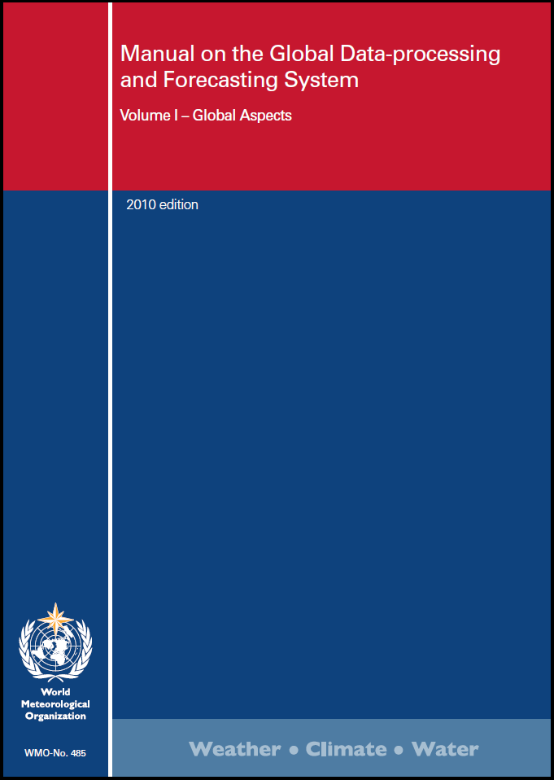
The Manual on the GDPFS
(WMO-No. 485)
A single source of technical regulations for all operational data-processing and forecasting systems operated by WMO Members
It includes the designation of meteorological centres, including those coordinated by CBS, jointly with other technical commission(s) and/or WMO Programme(s), as well as with other international organizations
Current version: https://www.wmo.int/pages/prog/www/DPFS/Manual/GDPFS-Manual.html
New Edition (in finalization): https://www.wmo.int/pages/prog/www/DPFS/Manual/Table-of-content_Manual-gdpfs.html

Slide 12
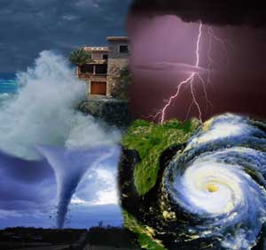
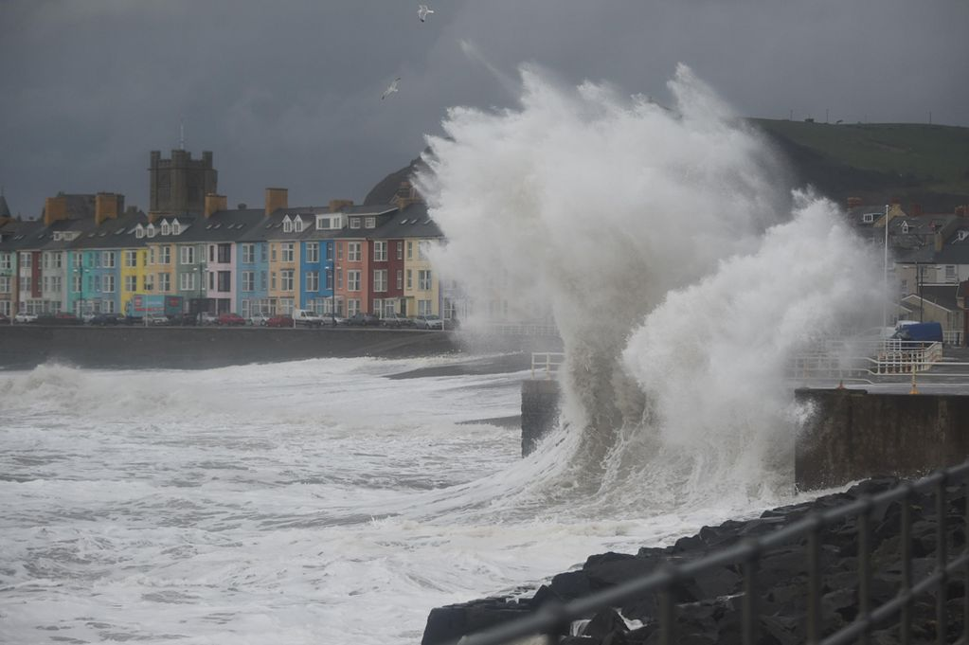
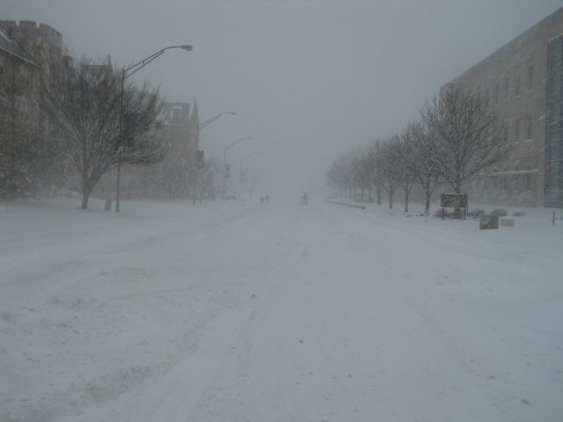
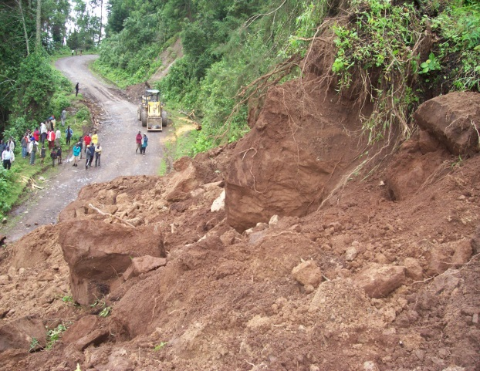
Why SWFDP?
Basic function and Mandate of NMHSs:
To provide weather information and services for protection of life, livelihood, property, and infrastructure, and for application sectors including conservation of environment
Mostly severe weather is responsible for hydrometeorological hazards and disasters

Slide 13
Why SWFDP?
Dramatic developments in weather and climate prediction science, and Service delivery concepts
Leading to improved alerting of hydro-meteorological hazards, at ever-increased precision, reliability, and lead-times of warnings
Developing countries, including LDCs and SIDS, saw little progress
Increasing gap in application of advanced tools and technology in forecasting and early warnings
WMO SWFDP attempts to close this gap, by applying the ‘Cascading Forecasting Process’ (regional frameworks)
?

Slide 14
SWFDP & its framework and guidance
  SWFDP started in 2006, is organized within the WMO Commission for Basic Systems (CBS) and taken care of by a Project Steering Group (PSG) established by CBS at WMO
  PSG has developed following two documents to detail overall project plan and provide guidelines for developing SWFDP Regional Subprojects
  SWFDP Overall Project Plan
  SWFDP Guidebook for Planning Regional Subprojects
  The SWFDP is cross-programmatic activity involving mainly GDPFS and PWS, and including other relevant programmes and projects including DRR, HWRP, TCP, MMO, SP, AgM, WWRP, ETR, LDCR, SIDS-MIT etc.

Slide 15
Vision
WM Congress provided vision for improving severe weather forecasting and warning services in developing countries
“NMHSs in developing countries are able to implement and maintain reliable and effective routine forecasting and severe weather warning programmes through enhanced use of NWP products and delivery of timely and authoritative forecasts and early warnings, thereby contributing to reducing the risk of disasters from natural hazards.” Cg-15 ( 2007) & Cg-16 (2011)
This WMO vision is realized through SWFDP

Slide 16
SWFDP Implementation process
Phase I: Overall Project Planning:
Establish regional partnerships including:
Strong commitment by the participating Members (NMHSs) in a geographical area
Identification & commitment of the possible Global and Regional Centres
the types of severe weather to focus on (starting with a few top hazards)
Preparation of products by Global and Regional centres
Developing project website and web portal (to be maintained by the lead Regional Centre)
Phase II: Regional Subproject Implementation Planning and Execution:
Establishing Regional Subproject Management Teams (RSMT)
Regional & National Implementation Plans (RSIPs & IPs)
Start prototype demonstration focusing on short to medium-range forecasting and warning services (1-2 years)
Capacity development through specialized training programmes on forecasting and service delivery
Submission of Quarterly Progress Reports by the NMHSs (verification, feedback, tracking etc.)
Continues….

Slide 17
SWFDP Implementation process
Phase III: Evaluation of the SWFDP Regional Subproject and broaden (return to I or II if necessary):
Evaluation of the progress reports
Tracking and analysis for further improvement
More countries, more hazards
Continuous evaluation, training and reporting
Phase IV: Regional Subproject Long-term Sustainability and Future Developments:
Sustain operations and expand partnerships through continuous development, regular trainings and sharing knowledge
Future capability and technology developments, and to foster broadening of activities in synergy with other WMO Programmes
Responsibility of management to be taken by the concerned Regional Association

Slide 18
SWFDP: Existing Regional Subprojects
    SWFDP-Southern Africa (Fully operational and sustained (Phase-IV))
    16 countries; RSMC Pretoria, RSMC-TC La Réunion
    SWFDDP-South Pacific Islands (In progress with full demonstration (Phase-III))
    9 Island States; RSMC Wellington, RSMC-TC Fiji
    SWFDP-Eastern Africa (In progress with full demonstration (Phase-III))
    7 countries; RSMC Nairobi, RFSC Dar Es Salaam
    SWFDP-Southeast Asia (In progress, demonstration since January 2016 (Phase-II))
    5 countries; RFSC Hanoi, RSMC-TC Tokyo, RSMC-TC New Delhi
    SWFDP-Bay of Bengal (in development (Phase-II))
    9 countries; RSMC New Delhi (including for TC)
    SWFDP-Central Asia (in development (Phase-II))
    4 countries; RSMC Tashkent
      Contributing Global Centres include: UKMO, ECMWF, NOAA/NCEP, ABoM, CMA, KMA, JMA, IMD, RosHydromet, EUMETSAT
      Involving 48 developing countries (29 of which are LDCs/SIDS)
      Several WMO programmes (i.e. GDPFS, PWS, TCP, DRR, MMO, AgM, SP, ETR, CD, LDC, RP, and WWRP) and WMO Technical Commissions (i.e. CBS, CAgM, CHy, JCOMM, and CAS)

Slide 19

SWFDP: Existing subprojects and Future directions
Presently, SWFDP involves 48 developing countries (including LDCs and SIDS) in Southern Africa, South Pacific, Eastern Africa, Southeast Asia, Bay of Bengal and Central Asia. However, subject to availability of resources, the number countries to benefit from SWFDP may grow to over 100 in next 5 years
Green color boxes represent the domains of existing SWFDP regional subprojects. Pink and Orange color boxes signify the regions for future SWFDP subprojects which will be developed within next 1-2 years and 3-5 years respectively. Contributing Global Centres and RSMCs /RFSCs are also shown for each of the SWFDP regional subprojects.
SWFDP Strengths:
Cost effective;
Simplicity;
NMHSs need internet only;
Highly operational focus;
Capacity development with improved forecasts and lead-time of warnings

Slide 20
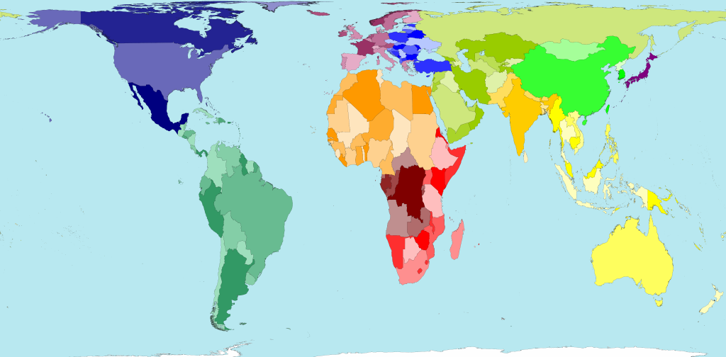
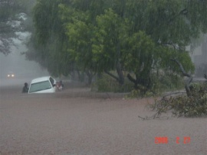
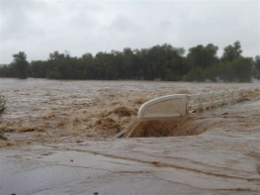
SWFDP: Making Efficient use of ‘Cascading Forecasting Process’
Global NWP centres to provide available NWP/EPS and sat-based products, including in the form of probabilities, cut to the project window frame;
Regional centres to analyses and interpret information received from global centres, prepare daily guidance products (out to day-5) for NMCs, run limited-area model to refine products, maintain RSMC Web site, liaise with the participating NMCs;
NMCs have access to all products, and maintained responsibility and authority over national warnings and services; to issue alerts, advisories, severe weather warnings; to liaise with user communities, and to contribute feedback and evaluation of the project.
User communities, including Disaster Management authorities
Global Centres
RSMC Pretoria
NMCs

Slide 21
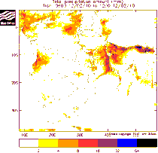
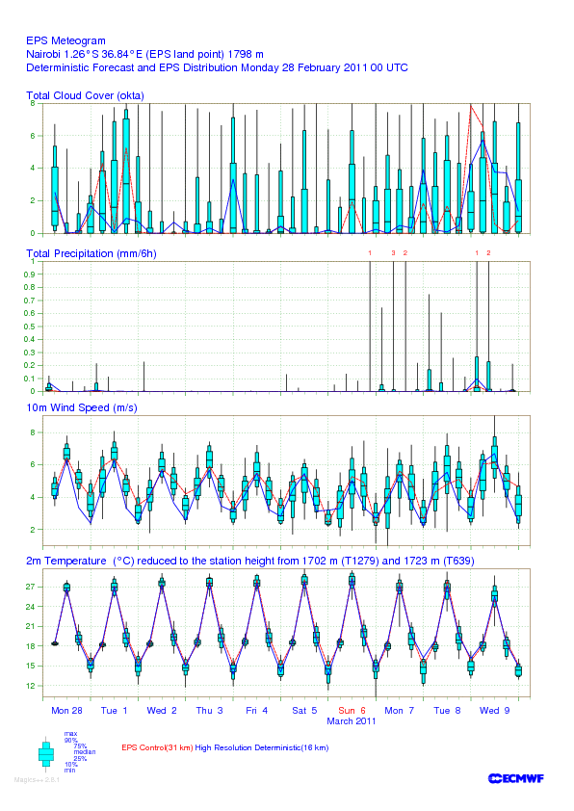
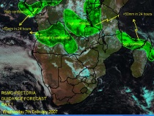
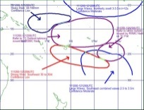
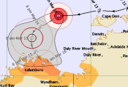
SWFDP: Making Efficient use of ‘Cascading Forecasting Process’
Flash Flood Guidance
(HWR)
Tailored Products for Applications (AgM, MMO)
Feedback and Verification
General Public, media, disaster management authorities
PWS, HWR,
WCP
General Public, media, disaster management authorities
PWS
Global NWP/EPS and
Sat-based products
Global Centres
Regional Centre (RSMCs, RFSC, RCCs)
National Met Centres
(Forecast/Warning Bulletins)
LAM & Guidance Products
(risk/probability)
AgM, MMO,
AeM, etc.
Specific User Sectors (Agriculture, Marine, Aviation, etc.)
RSMCs-TC
TCP
Nowcasting products and guidance
GDPFS
Capacity Development (CD), including Training (ETR)
WWRP
Satellite Imagery and Tools
(SP)
Observing and information systems
(WIGOS, WIS)
Research Projects

Slide 22
Service delivery aspects and value of information
(e.g. 90%)
Value
(e.g. 40%)
Providers ---- users ------- end users
(NMHSs)

Slide 23
Value-adding process for decision-supporting services
This value-adding process is visualized through the Value Chain

Slide 24
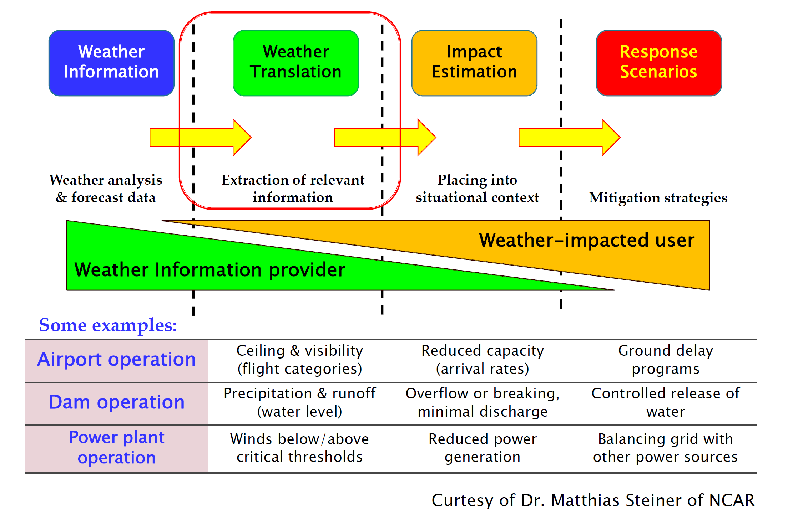
Value-adding process for decision-supporting services
Determining impact: from weather to response scenarios

Slide 25
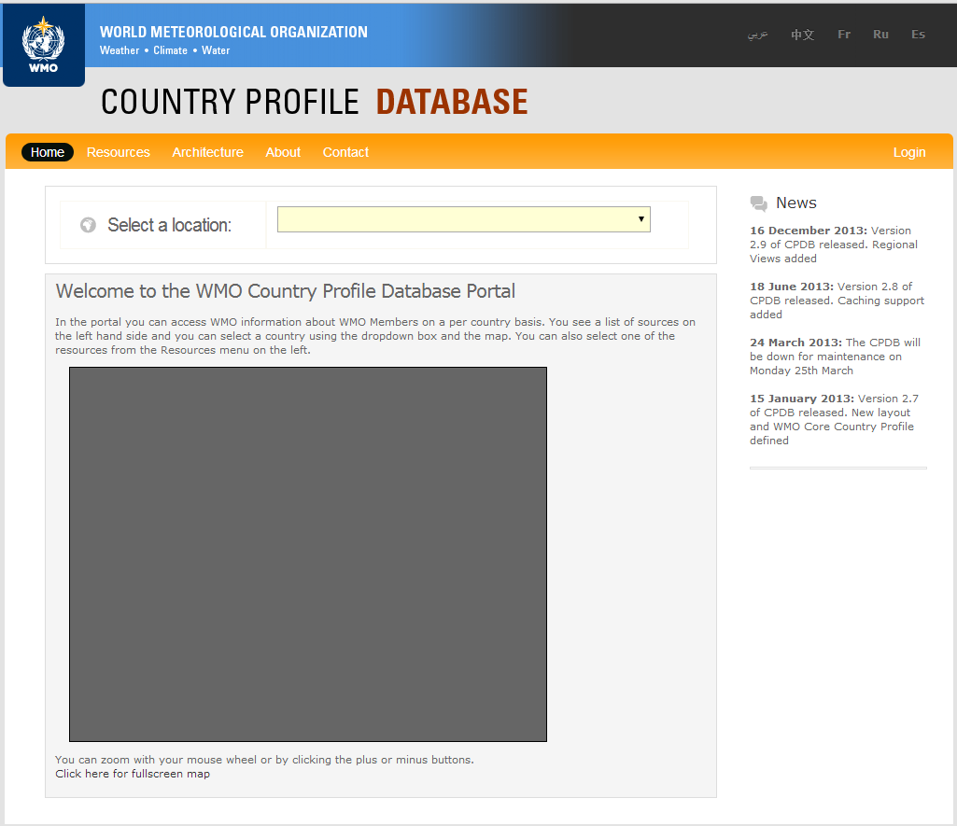
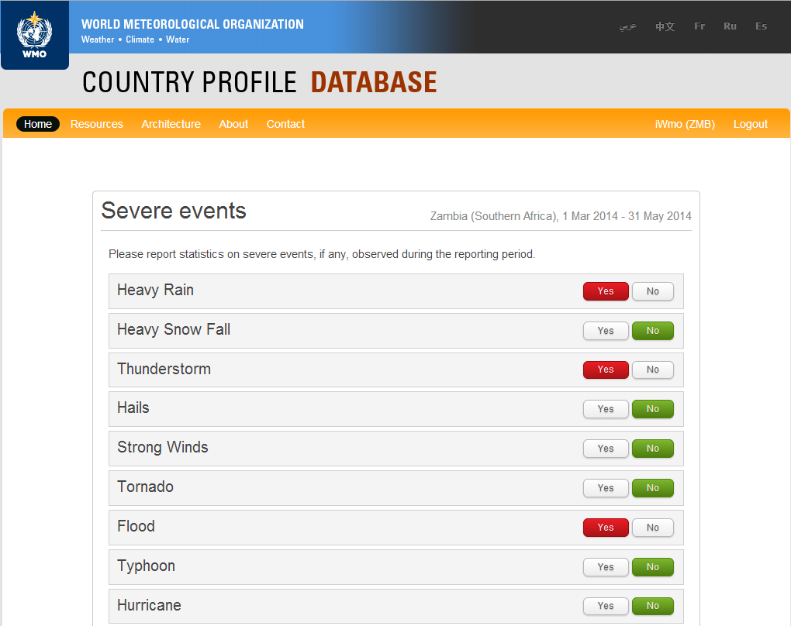
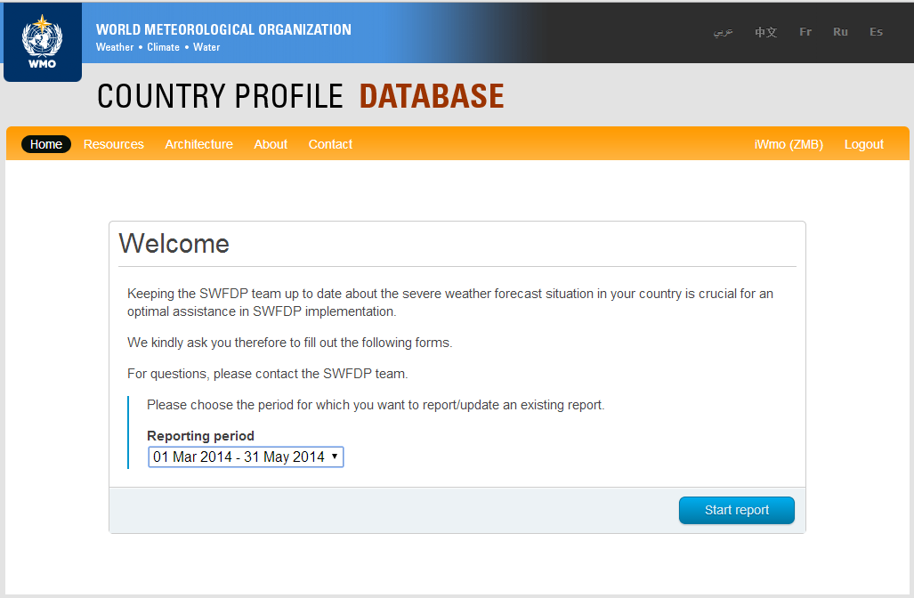
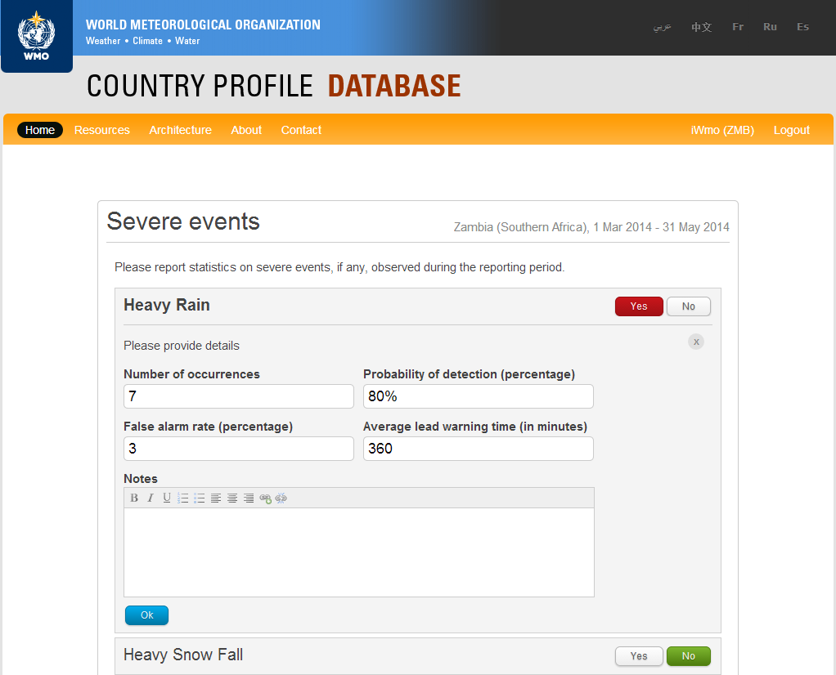
Reporting Mechanism
Submission of Quarterly Progress Reports online through CPDB (SWFDP Database)
https://www.wmo.int/cpdb/

Slide 26
Quarterly Progress Report
Key elements & information to be reported in the Quarterly Progress Report (to be submitted on-line through SWFDP database)
Reporting Period (Start date to end date)
Severe events (e.g. heavy rainfall, strong winds, high waves, flooding etc.)
Reporting period highlights (e.g. duration and amount of rainfall, impact of rainfall and/or strong wind and high waves, affected areas, damages (if any), coordination with disaster management offices etc.)
Clients (e.g. Disaster Management Offices, media, humanitarian organizations etc. New clients can also be added)
Client feedback (e.g. adequacy and effectiveness of the warning and how it was used etc.)
Desired products (e.g. NMHS may propose a demand for additional product(s) from global and/or regional centres if already not available etc.)
Forecast Period and Area (to provide information about area of responsibility of an NMHS and the period for which NMHS issues forecast etc.)
Dissemination channels (e.g. TV, radio, mobile SMS etc. New channel can also added)
Continues……

Slide 27
Quarterly Progress Report
Key elements & information to be reported in the Quarterly Progress Report (to be submitted on-line through SWFDP database)
Observing Systems (e.g. basic synoptic network, AWS network, radar and satellite information receiving stations etc.)
Workshop (to provide title, duration and summary outcome of the training workshops arranged for the forecasters, emergency managers, media, school officials, general public etc. during the reporting period)
Product usage (to select various products which are available from participating global and regional centres and are used in making forecasts at national level etc.)
Local forecasting tools (to provide information about the existing forecasting tools used at the NMHS and any new forecasting tool implemented at the NMHS etc.)
Resources (to provide information about the budget of NMHS and the number of forecasters and observers working in NMHS etc.)
Case Studies (to provide title and description of case studies related to the severe event(s) observed during the reporting period, key findings of the study etc.)
Related projects (to provide information about the on-going and new related projects etc.)

Slide 28
Conclusions
Since its inception in 2006, SWFDP has proven to bring significant benefits for participating Members in improving forecasts of high impact weather and warning services, thus contributing to DRR, climate change adaptation and resilience, and socioeconomic development etc.
SWFDP concepts and approach is flexible to adjust to the needs of various geographical areas of the world
SWFDP has potential for expansion to benefit more developing countries including LDCs and SIDS/MITs
It can potentially provide operational support to Multi-Hazard Early Warning Systems (MHEWS) at regional and national levels respectively
Challenges/ Implications
Training for trainers: Sharing of knowledge by trained forecasters with their fellow operational forecasters
Commitment of NMHSs for sending feedback on regular basis
Engagement of NMHSs with users and stakeholders to introduce and implement impact informed forecasts and warnings
How to sustain capacity development process
As SWFDP regional subprojects are supported through extra-budgetary resources, it is quite challenging on how to ensure resources to continue existing subprojects and develop new subprojects, plus develop synergies with other relevant projects (like FFGS, CIFDP etc.)

Slide 29
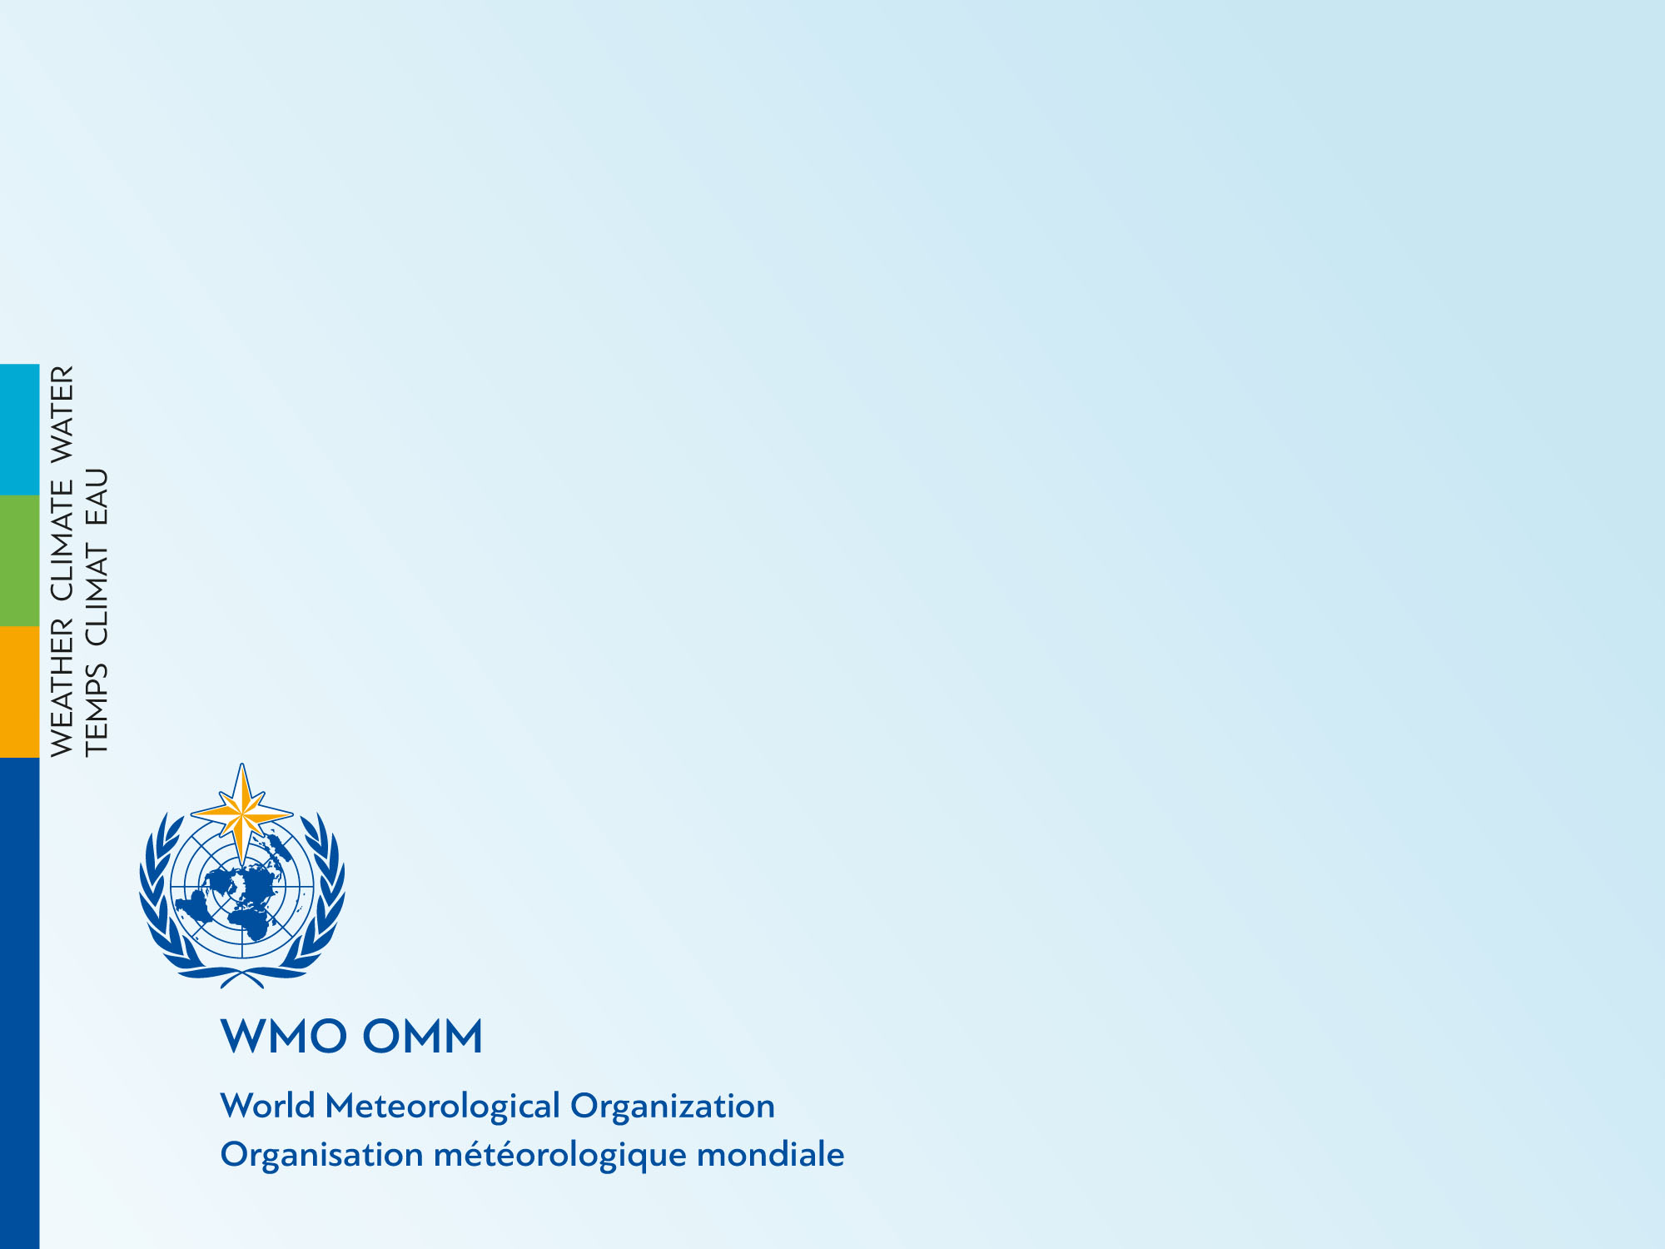
Thank you
Merci

Slide 30
UN-ISDR: Sendai Framework for DRR 2015-2030
Expected outcome: → substantial reduction of disaster risk and losses of lives, livelihood, health and assets
Goal: → Prevent new and reduce existing risk and thus strengthen resilience
7 global targets of which target g) is more relevant to WMO: “substantially increase the availability of and access to MHEWS and disaster risk information and assessments to the people by 2030”
Calls for coherence in policies and programmes across sustainable development, environment and climate to ensure the reduction of disaster risk.
→ tasks the UN system entities and other IOs to support countries within their respective mandates through the UN Plan of Action on DRR for Resilience, UN Development Assistance Framework (UNDAFs), International Health Regulations, UN Climate Change and Sustainable Development Strategies, etc.

Slide 31
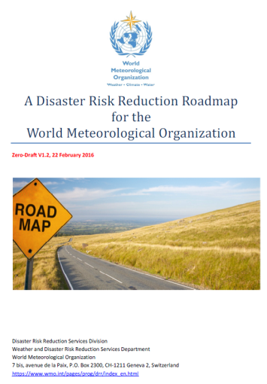
UN-ISDR: Sendai Framework for DRR 2015-2030
WMO contributions to the implementation of the Sendai Framework and UN Plan of Action on DRR for Resilience:
Hazard analysis: standardization of hazard information to support risk assessments, prevention measures, sectoral planning, etc.
Impact-based forecasts and risk-informed warnings: communicating physical impacts of forecasted phenomena for effective response
Strengthening MHEWS: active engagement in the International Network for MHEWS (IN-MHEWS), the organization of the International Conference on MHEWS (IC-MHEWS) → links to the Climate Risk and Early Warning Systems (CREWS) initiative, the GFCS and other hazard-specific early warning activities within WMO
New and strengthened existing partnerships and network engagements
WMO DRR Roadmap developed and approved by EC-68

Slide 32
UNFCCC: 2015 Paris Agreement
Paris Agreement: Composed of 16 preamble clauses and 29 operative clauses (Articles) guided by UNFCCC’s principles, incl. the one of equity and common but differentiated responsibilities
Highlights (relevant to WMO):
Article 2: limit the temperature increase, increase the ability to adapt to the adverse impacts of climate change, foster climate resilience and low greenhouse gas emissions development, making finances flow
Article 3: all Parties, in the context of nationally determined contributions (NDCs) to the global response to climate change, are to undertake and communicate ambitious efforts achieving the purpose of the Agreement
Article 7: establish the global goal on adaptation of enhancing adaptive capacity, strengthening resilience and reducing vulnerability to climate change…
Article 8: averting, minimizing and addressing loss and damage associated with the adverse effects of climate change, including extreme weather events and slow-onset events,…EWS, emergency preparedness, risk assessment, resilience etc.
Article 11: Capacity building of developing countries in particular LDCs and SIDS
Article 12: Climate change education, training and public awareness

Slide 33

The 2030 Agenda for Sustainable Development: SDGs versus weather, climate & water
17 Sustainable Development Goals (SDGs): to address key issues including poverty, hunger, food security, healthy lives, gender equality, energy, resilience, inequality within and among countries, resilient cities and human settlements, climate change and its impact, strengthen global partnership etc.
3 main dimensions: social, economic, environment
WMO position:
Climate change adaptation, disaster risk management and resilience building should be accounted for in all weather- and climate- sensitive sectors
Support national integrated action plans, anchor WMO expertise within the UN system
Strengthening the role and relevance of the RAs
Pro-active in developing new partnerships, engage PRs beyond the constituent bodies
Decisions with middle-and long-term time horizons should be science-based
→ Provide the best data and scientific knowledge
Human and technical infrastructures are pivotal to maintain, strengthen and develop capacities for implementation → Open WMO infrastructures to more partners and mobilize WMO experts

